Slide 1

Principle Component Analysis
For Dimension Reduction
Prof. Mingkui Tan
mingkuitan@scut.edu.cn
South China University of Technology
Southern Artificial Intelligence Laboratory(SAIL)

Slide 2
General Plan
1
Motivations
2
Dimension Reduction
3
Principle Component Analysis
4
More Discussions
Notes:
我的汇报包括以下四个部分内容

Slide 3
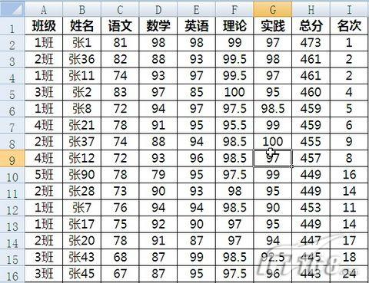
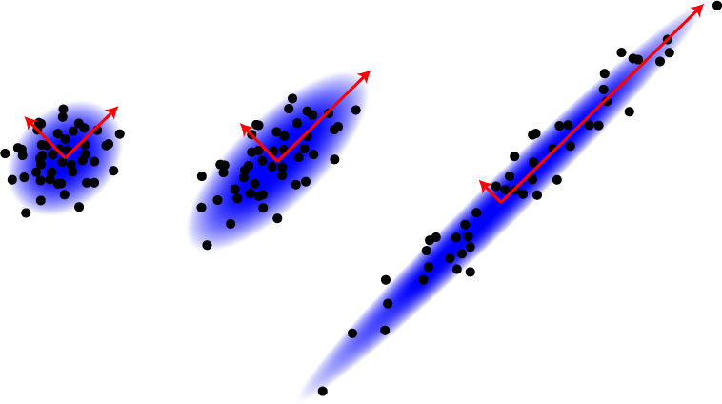
Data Redundancy
Data may contain very similar or even the same columns
Highly Correlated Data!
Curse of Dimensionality for Big Data!

Slide 4
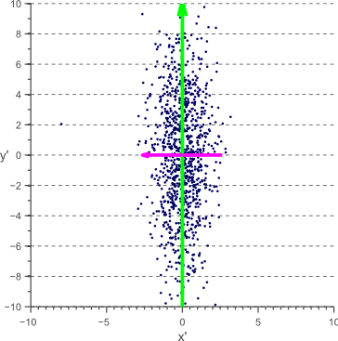
Noises
Some columns are random noises
Highly contaminated!

Slide 5
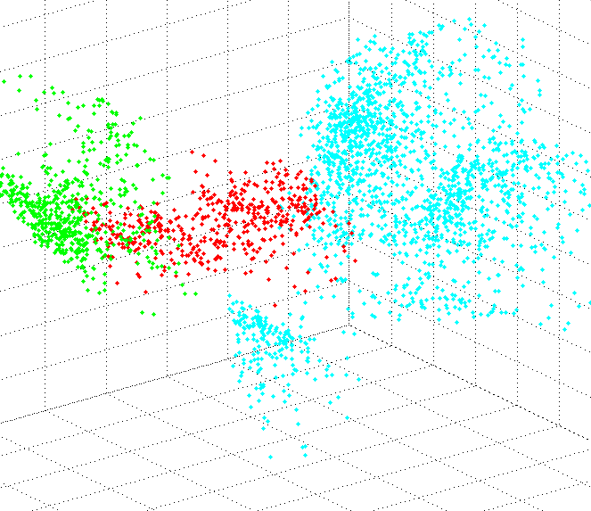
Data Visualization

Slide 6

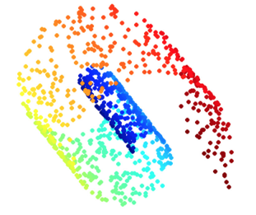
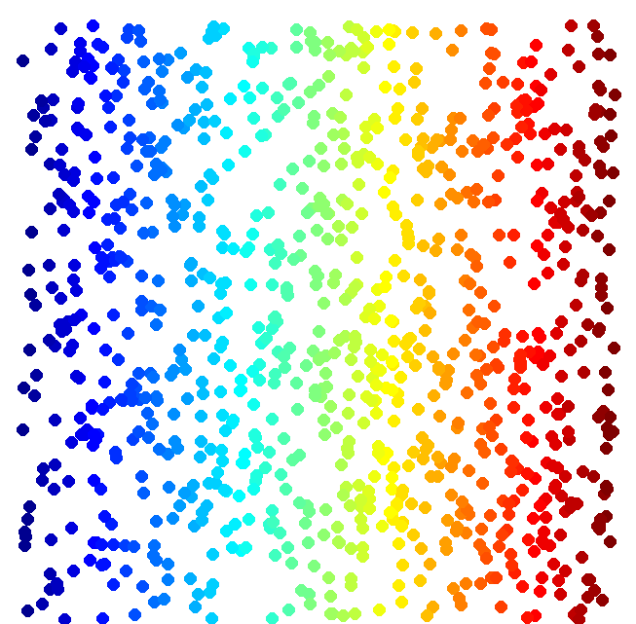
Dimension Reduction
to
High dimension
vector x
Low dimension
vector x’
Looks like 3-D
Actually, 2-D
Notes:
http://reuter.mit.edu/blue/images/research/manifold.png
http://archive.cnx.org/resources/51a9b2052ae167db310fda5600b89badea85eae5/isomapCNXtrue1.png

Slide 7

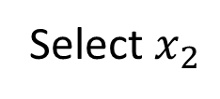


Distributed Representation
to
Feature selection
Principle component analysis (PCA)
High dimension vector x
Low dimension vector z
$$x_{2}$$
Select $x_{2}$
?
$$x_{1}$$
$$z=Wx$$

Slide 8
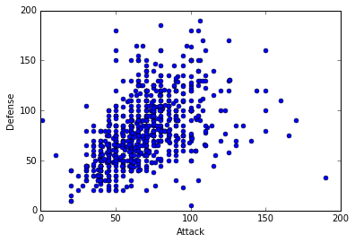

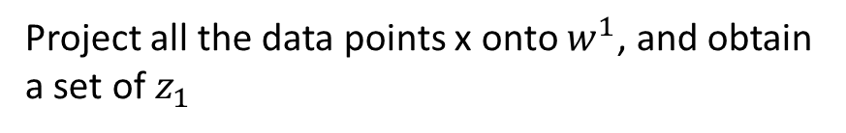





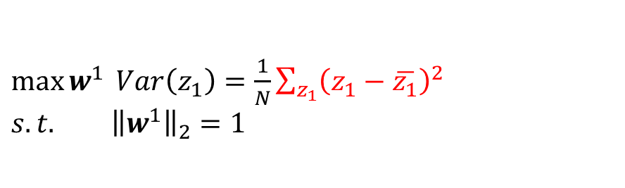
PCA
Large variance
$$z=Wx$$
Reduce to 1-D:
$$z_{1}=w^{1}∙x$$
$$x$$
Small variance
Project all the data points x onto $w^{1}$, and obtain a set of $z_{1}$
$$w^{1}$$
We want the variance of $z_{1}$ as large as possible
$$z_{1}=w^{1}∙x$$
$\max{w^{1}} Var\left(z_{1}\right)=\frac{1}{N}\sum_{z_{1}}{{\left(z_{1}−\overline{z_{1}}\right)}^{2} }$ ${s.t. \left\|w^{1}\right\|}_{2}=1$

Slide 9





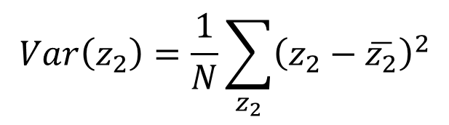
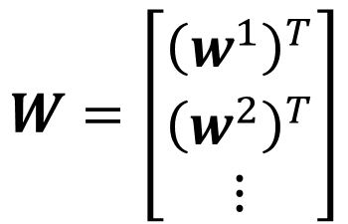
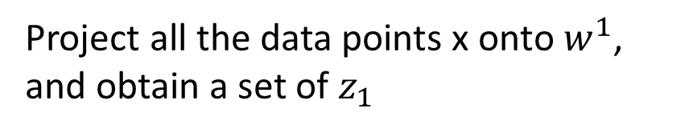



PCA
Project all the data points x onto $w^{1}$, and obtain a set of $z_{1}$
$$z=Wx$$
We want the variance of $z_{1}$ as large as possible
Reduce to 1-D:
$$\max{w^{1}} Var\left(z_{1}\right)=\frac{1}{N}\sum_{z_{1}}{{\left(z_{1}−\overline{z_{1}}\right)}^{2} }$$
$${s.t. \left\|w^{1}\right\|}_{2}=1$$
$$z_{1}=w^{1}∙x$$
$$z_{2}=w^{2}∙x$$
We want the variance of $z_{2}$ as large as possible
$$W=\left[\begin{aligned}{\left(w^{1}\right)}^{T} \\ {\left(w^{2}\right)}^{T} \\ ⋮\end{aligned}\right]$$
$$Var\left(z_{2}\right)=\frac{1}{N}\sum_{z_{2}}{{\left(z_{2}−\overline{z_{2}}\right)}^{2}}$$
$${\left\|w^{2}\right\|}_{2}=1$$
$$w^{1}∙w^{2}=0$$
Orthogonal matrix

Slide 10
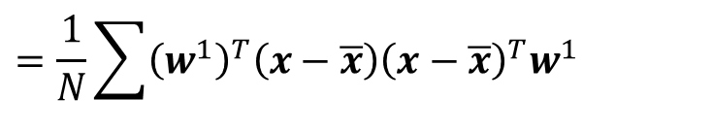


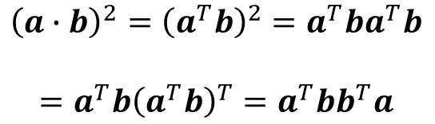

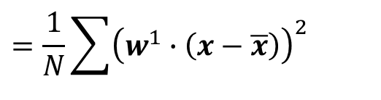

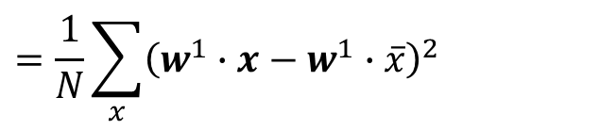


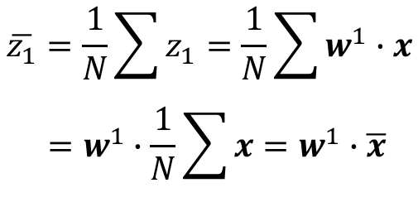
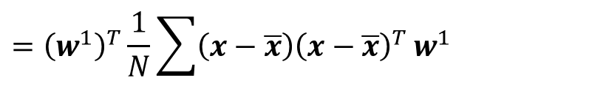
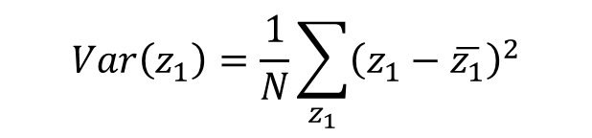
Formula Derivation
$$z_{1}=w^{1}∙x$$
$$Var\left(z_{1}\right)=\frac{1}{N}\sum_{z_{1}}{{\left(z_{1}−\overline{z_{1}}\right)}^{2}}$$
$$\overline{z_{1}}=\frac{1}{N}\sum{z_{1}}=\frac{1}{N}\sum{w^{1}∙x}$$
$$=w^{1}∙\frac{1}{N}\sum{x}=w^{1}∙\overline{x}$$
$$=\frac{1}{N}\sum_{x}{{\left(w^{1}∙x−w^{1}∙\overline{x}\right)}^{2}}$$
$$=\frac{1}{N}\sum{{\left(w^{1}∙\left(x−\overline{x}\right)\right)}^{2}}$$
$${\left(a∙b\right)}^{2}={\left(a^{T}b\right)}^{2}=a^{T}ba^{T}b$$
$$=a^{T}b{\left(a^{T}b\right)}^{T}=a^{T}bb^{T}a$$
$$=\frac{1}{N}\sum{{\left(w^{1}\right)}^{T}\left(x−\overline{x}\right){\left(x−\overline{x}\right)}^{T}w^{1}}$$
Find $w^{1}$ maximizing
$${\left(w^{1}\right)}^{T}Sw^{1}$$
$$={\left(w^{1}\right)}^{T}\frac{1}{N}\sum{\left(x−\overline{x}\right){\left(x−\overline{x}\right)}^{T}}w^{1}$$
$${\left\|w^{1}\right\|}_{2}={\left(w^{1}\right)}^{T}w^{1}=1$$
$$={\left(w^{1}\right)}^{T}Cov\left(x\right)w^{1}$$
$$S=Cov\left(x\right)$$

Slide 11

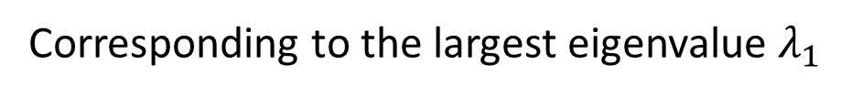

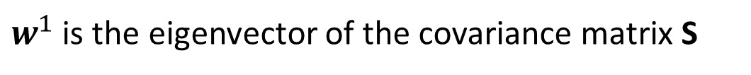


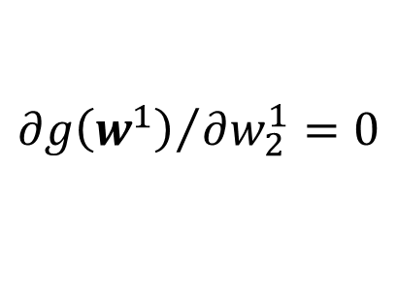
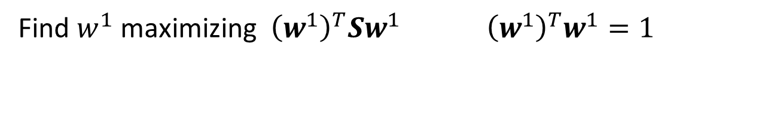
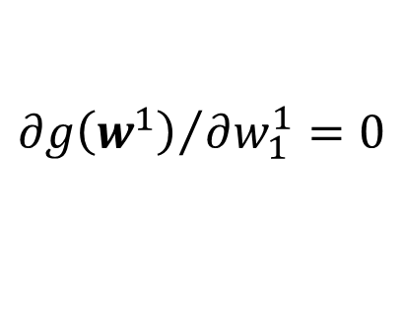

Formula Derivation
Find $w^{1}$ maximizing ${\left(w^{1}\right)}^{T}Sw^{1}{ \left(w^{1}\right)}^{T}w^{1}=1$
Symmetric
Positive-semidefinite
$$S=Cov\left(x\right)$$
(non-negative eigenvalues)
Using Lagrange multiplier:
$g\left(w^{1}\right)=$ ${\left(w^{1}\right)}^{T}Sw^{1}−α\left({\left(w^{1}\right)}^{T}w^{1}−1\right)$
$${∂g\left(w^{1}\right)}/{∂w_{1}^{1}=0}$$
$$Sw^{1}−αw^{1}=0$$
$${∂g\left(w^{1}\right)}/{∂w_{2}^{1}=0}$$
$$Sw^{1}=αw^{1}$$
$w^{1}$ : eigenvector
$${\left(w^{1}\right)}^{T}Sw^{1}=α{\left(w^{1}\right)}^{T}w^{1}$$
$$=α$$
…
Choose the maximum one
$w^{1}$ is the eigenvector of the covariance matrix S
Corresponding to the largest eigenvalue $λ_{1}$
Notes:
• The eigenvalues for symmetric matrices are always real.
a symmetric {\displaystyle n} × {\displaystyle n} real matrix {\displaystyle M} is said to be positive definite if the scalar {\displaystyle z^{\mathrm {T} }Mz} is positive for every non-zero column vector {\displaystyle z} of {\displaystyle n} real numbers
zTMz>=0
Ref: http://speech.ee.ntu.edu.tw/~tlkagk/courses/LA_2016/Lecture/special%20matrix%20(v2).ecm.mp4/index.html

Slide 12


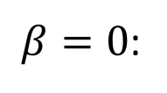

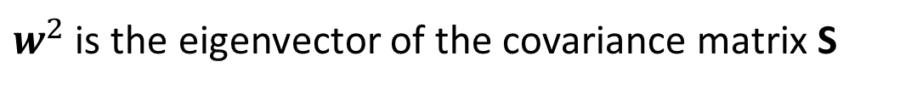








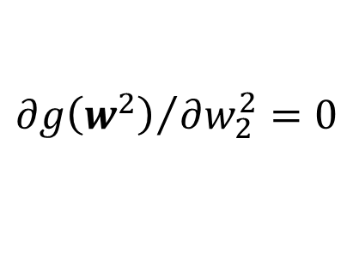


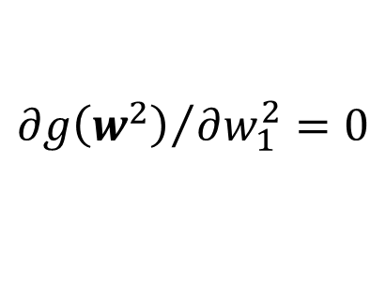

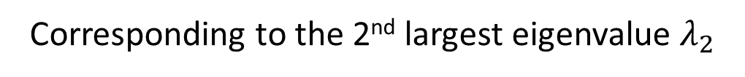
Formula Derivation
Find $w^{2}$ maximizing
$${\left(w^{2}\right)}^{T}Sw^{2}$$
$${\left(w^{2}\right)}^{T}w^{2}=1$$
$${\left(w^{2}\right)}^{T}w^{1}=0$$
$g\left(w^{2}\right)=$ ${\left(w^{2}\right)}^{T}Sw^{2}−α\left({\left(w^{2}\right)}^{T}w^{2}−1\right)$
$$−β\left({\left(w^{2}\right)}^{T}w^{1}−0\right)$$
$${∂g\left(w^{2}\right)}/{∂w_{1}^{2}=0}$$
$$Sw^{2}−αw^{2}−βw^{1}=0$$
0
0
1
$${∂g\left(w^{2}\right)}/{∂w_{2}^{2}=0}$$
$${\left(w^{1}\right)}^{T}Sw^{2}−α{\left(w^{1}\right)}^{T}w^{2}−β{\left(w^{1}\right)}^{T}w^{1}=0$$
$$={\left({\left(w^{1}\right)}^{T}Sw^{2}\right)}^{T}$$
$$={\left(w^{2}\right)}^{T}S^{T}w^{1}$$
…
$$={\left(w^{2}\right)}^{T}Sw^{1}$$
$$=λ_{1}{\left(w^{2}\right)}^{T}w^{1}$$
$$=0$$
$$Sw^{1}=λ_{1}w^{1}$$
$β=0$:
$$Sw^{2}−αw^{2}=0$$
$$Sw^{2}=αw^{2}$$
$w^{2}$ is the eigenvector of the covariance matrix S
Corresponding to the 2nd largest eigenvalue $λ_{2}$

Slide 13
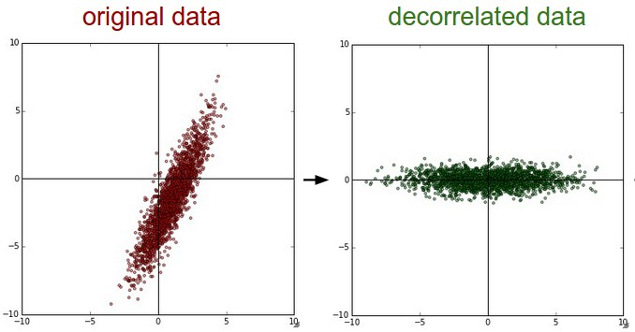










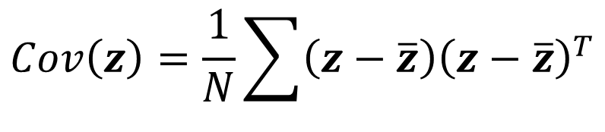




PCA - Decorrelation
$$z=Wx$$
$$x_{2}$$
$$z_{2}$$
$$Cov\left(z\right)=D$$
$$x_{1}$$
$$z_{1}$$
Diagonal matrix
PCA
$$Cov\left(z\right)=\frac{1}{N}\sum{\left(z−\overline{z}\right){\left(z−\overline{z}\right)}^{T}}$$
$$=WSW^{T}$$
$$S=Cov\left(x\right)$$
$$=WS\left[\begin{matrix}w^{1} & ⋯ & w^{K}\end{matrix}\right]$$
$$=W\left[S\begin{matrix}w^{1} & ⋯ & Sw^{K}\end{matrix}\right]$$
$$=W\left[λ_{1}\begin{matrix}w^{1} & ⋯ & λ_{K}w^{K}\end{matrix}\right]$$
$$=\left[λ_{1}\begin{matrix}{Ww}^{1} & ⋯ & λ_{K}{Ww}^{K}\end{matrix}\right]$$
$$=\left[λ_{1}\begin{matrix}e_{1} & ⋯ & λ_{K}e_{K}\end{matrix}\right]$$
$$=D$$
Diagonal matrix

Slide 14

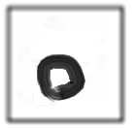

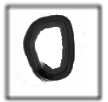




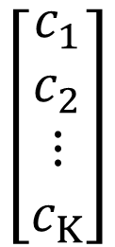
PCA – Another Point of View
Basic Component:
1
0
1
0
1
…….
u¹
u²
u³
u⁴
u⁵
$$\left[\begin{aligned}1 \\ 0 \\ 1 \\ 0 \\ 1 \\ ⋮\end{aligned}\right]$$
1x
1x
1x
$$≈$$
+
+
u¹
u³
u⁵
$$\left[\begin{aligned}c_{1} \\ c_{2} \\ ⋮ \\ c_{K}\end{aligned}\right]$$
$$x≈c_{1}u^{1}+c_{2}u^{2}+⋯+c_{K}u^{K}+\overline{x}$$
Represent a digit image
Pixels in a digit image
component
Notes:
https://pvirie.wordpress.com/2016/03/29/linear-autoencoders-do-pca/
https://pvirie.wordpress.com/2013/10/01/pattern-covariance-analysis-of-components/

Slide 15

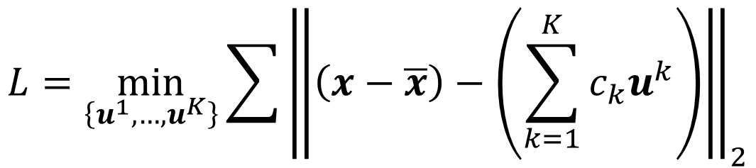

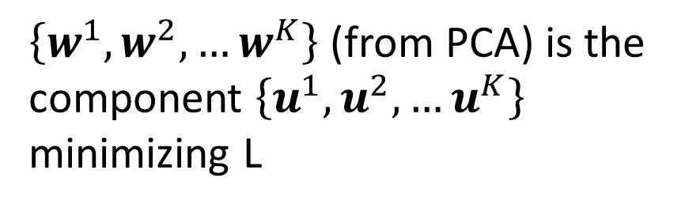


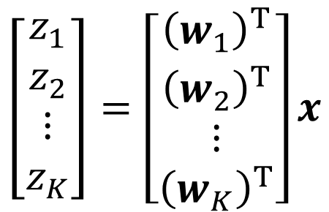

PCA – Another Point of View
$$x−\overline{x}≈c_{1}u^{1}+c_{2}u^{2}+⋯+c_{K}u^{K}$$
$$=\hat{x}$$
Reconstruction error:
Find $\left\{u^{1},…,u^{K}\right\}$ minimizing the error
$${\left\| (x−\overline{x})−\hat{x}\right\|}_{2}$$
$$L=\min_{\left\{u^{1},…,u^{K}\right\}}{\sum{{\left\|\left(x−\overline{x}\right)−\left(\sum_{k=1}^{K}{c_{k}u^{k}}\right)\right\|}_{2}}}$$
PCA:
$$z=Wx$$
$$\hat{x}$$
$$\left[\begin{aligned}z_{1} \\ z_{2} \\ ⋮ \\ z_{K}\end{aligned}\right]=\left[\begin{aligned}{\left(w_{1}\right)}^{T} \\ {\left(w_{2}\right)}^{T} \\ ⋮ \\ {\left(w_{K}\right)}^{T}\end{aligned}\right]x$$
$\left\{w^{1},w^{2},…w^{K}\right\}$ (from PCA) is the component $\left\{u^{1},u^{2},…u^{K}\right\}$ minimizing L
Proof in [Bishop, Chapter 12.1.2]

Slide 16













PCA – Another Point of View
$$x−\overline{x}≈c_{1}u^{1}+c_{2}u^{2}+⋯+c_{K}u^{K}$$
$$=\hat{x}$$
Reconstruction error:
Find $\left\{u^{1},…,u^{K}\right\}$ minimizing the error
$${\left\| (x−\overline{x})−\hat{x}\right\|}_{2}$$
$$x^{1}−\overline{x}≈c_{1}^{1}u^{1}+c_{2}^{1}u^{2}+⋯$$
$$x^{2}−\overline{x}≈c_{1}^{2}u^{1}+c_{2}^{2}u^{2}+⋯$$
$$x^{3}−\overline{x}≈c_{1}^{3}u^{1}+c_{2}^{3}u^{2}+⋯$$
……
$$≈$$
u¹
u²
$$c_{1}^{1}$$
$$c_{1}^{2}$$
$$c_{1}^{3}$$
…
…
$$c_{2}^{1}$$
$$c_{2}^{2}$$
$$c_{2}^{3}$$
Minimize Error
…
…
…
Matrix X
Notes:
Link PCA with MDS
[1] T. Cox and M. Cox. Multidimensional Scaling. Chapman Hall, Boca Raton, 2nd edition, 2001.

Slide 17









PCA – Another Point of View
$$x^{1}−\overline{x}$$
u¹
u²
$$c_{1}^{1}$$
$$c_{1}^{2}$$
$$c_{1}^{3}$$
…
$$≈$$
…
$$c_{2}^{1}$$
$$c_{2}^{2}$$
$$c_{2}^{3}$$
Minimize Error
…
…
…
Matrix X
M x N
M x K
K x K
K x N
X
U
∑
V
$$≈$$
K columns of U: a set of orthonormal eigen vectors corresponding to the K largest eigenvalues of XX^{T}
This is the solution of PCA

Slide 18





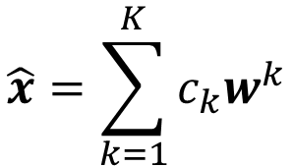

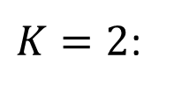

Autoencoder
PCA looks like a neural network with one hidden layer (linear activation function)
If $\left\{w^{1},w^{2},…w^{K}\right\}$ is the component $\left\{u^{1},u^{2},…u^{K}\right\}$
$$\hat{x}=\sum_{k=1}^{K}{c_{k}w^{k}}$$
$$x−\overline{x}$$
To minimize reconstruction error:
$K=2$:
$$c_{k}=\left(x−\overline{x}\right)∙w^{k}$$
$$w_{1}^{1}$$
$$c_{1}$$
$$x−\overline{x}$$
$$w_{2}^{1}$$
$$w_{3}^{1}$$
Notes:
$$K=2$$

Slide 19

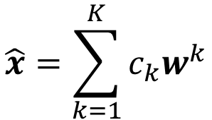

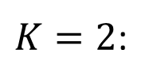





Autoencoder
PCA looks like a neural network with one hidden layer (linear activation function)
If $\left\{w^{1},w^{2},…w^{K}\right\}$ is the component $\left\{u^{1},u^{2},…u^{K}\right\}$
$$\hat{x}=\sum_{k=1}^{K}{c_{k}w^{k}}$$
$$x−\overline{x}$$
To minimize reconstruction error:
$K=2$:
$$c_{k}=\left(x−\overline{x}\right)∙w^{k}$$
$$c_{1}$$
$$x−\overline{x}$$
$$w_{1}^{2}$$
$$c_{2}$$
$$w_{2}^{2}$$
$$w_{3}^{2}$$
Notes:
$$K=2$$

Slide 20






Autoencoder
PCA looks like a neural network with one hidden layer (linear activation function)
If $\left\{w^{1},w^{2},…w^{K}\right\}$ is the component $\left\{u^{1},u^{2},…u^{K}\right\}$
$$\hat{x}=\sum_{k=1}^{K}{c_{k}w^{k}}$$
$$x−\overline{x}$$
To minimize reconstruction error:
$K=2$:
$$c_{k}=\left(x−\overline{x}\right)∙w^{k}$$
$$w_{1}^{1}$$
$${\hat{x}}_{1}$$
$$c_{1}$$
$$w_{2}^{1}$$
$$x−\overline{x}$$
$$w_{1}^{2}$$
$${\hat{x}}_{2}$$
$$c_{2}$$
$$w_{3}^{1}$$
$$w_{2}^{2}$$
$$w_{3}^{2}$$
$${\hat{x}}_{3}$$
Notes:
$$K=2$$

Slide 21






Autoencoder
PCA looks like a neural network with one hidden layer (linear activation function)
If $\left\{w^{1},w^{2},…w^{K}\right\}$ is the component $\left\{u^{1},u^{2},…u^{K}\right\}$
$$\hat{x}=\sum_{k=1}^{K}{c_{k}w^{k}}$$
To minimize reconstruction error:
$$x−\overline{x}$$
$$c_{k}=\left(x−\overline{x}\right)∙w^{k}$$
$K=2$:
It can be deep.
Deep Autoencoder
$${\hat{x}}_{1}$$
$$c_{1}$$
Minimize error
$$w_{1}^{2}$$
$$x−\overline{x}$$
$${\hat{x}}_{2}$$
$$x−\overline{x}$$
$$w_{1}^{2}$$
$$c_{2}$$
$$w_{2}^{2}$$
$$w_{2}^{2}$$
Gradient Descent?
$$w_{3}^{2}$$
$${\hat{x}}_{3}$$
$$w_{3}^{2}$$
Notes:
$$K=2$$

Slide 22
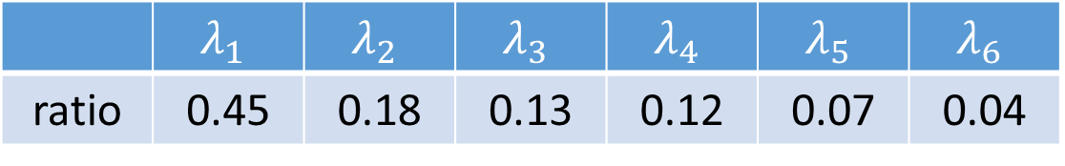
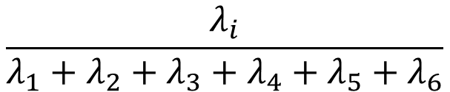
PCA - Pokémon
Inspired from: https://www.kaggle.com/strakul5/d/abcsds/pokemon/principal-component-analysis-of-pokemon-data
800 Pokemons, 6 features for each (HP, Atk, Def, Sp Atk, Sp Def, Speed)
How many principle components?
$$\frac{λ_{i}}{λ_{1}+λ_{2}+λ_{3}+λ_{4}+λ_{5}+λ_{6}}$$
ratio | 0.45 | 0.18 | 0.13 | 0.12 | 0.07 | 0.04
Using 4 components is good enough
Notes:
[ 0.45190665 0.18225358 0.12979086 0.12011089 0.07142337 0.04451466]

Slide 23

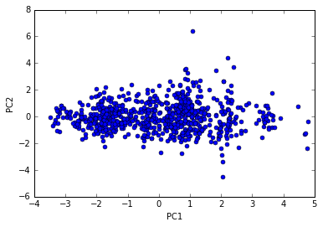

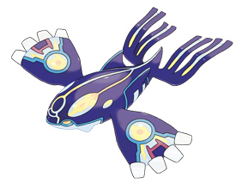

PCA - Pokémon
 | HP | Atk | Def | Sp Atk | Sp Def | Speed
PC1 | 0.4 | 0.4 | 0.4 | 0.5 | 0.4 | 0.3
PC2 | 0.1 | 0.0 | 0.6 | -0.3 | 0.2 | -0.7
PC3 | -0.5 | -0.6 | 0.1 | 0.3 | 0.6 | 0.1
PC4 | 0.7 | -0.4 | -0.4 | 0.1 | 0.2 | -0.3
强度
防御(牺牲速度)

Slide 24
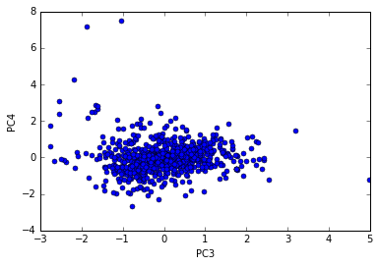


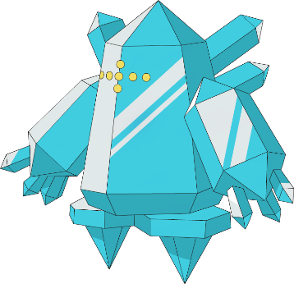

PCA - Pokémon
 | HP | Atk | Def | Sp Atk | Sp Def | Speed
PC1 | 0.4 | 0.4 | 0.4 | 0.5 | 0.4 | 0.3
PC2 | 0.1 | 0.0 | 0.6 | -0.3 | 0.2 | -0.7
PC3 | -0.5 | -0.6 | 0.1 | 0.3 | 0.6 | 0.1
PC4 | 0.7 | -0.4 | -0.4 | 0.1 | 0.2 | -0.3
特殊防御 (牺牲攻击和生命)
生命力强
Notes:
幸福蛋
雷吉艾斯
壺壺

Slide 25
PCA - Pokémon
http://140.112.21.35:2880/~tlkagk/pokemon/pca.html
The code is modified from
http://jkunst.com/r/pokemon-visualize-em-all/

Slide 26

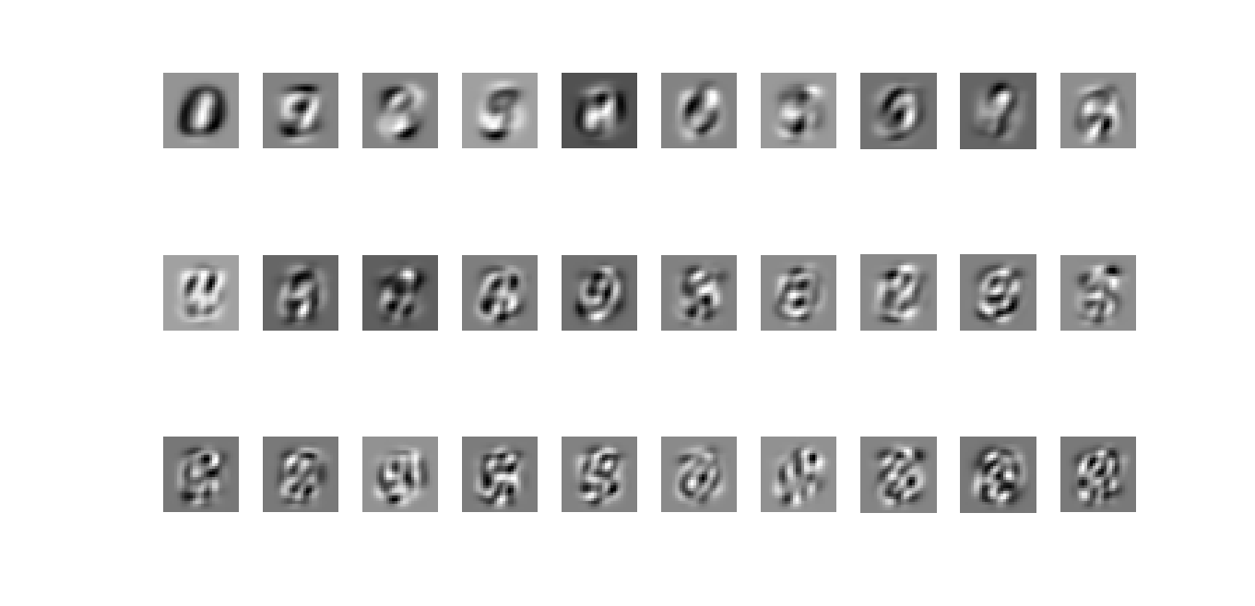

PCA - MNIST
$$=a_{1}w^{1}+a_{2}w^{2}+⋯$$
30 components:
images
Eigen-digits

Slide 27


PCA - Face
30 components:
http://www.cs.unc.edu/~lazebnik/research/spring08/assignment3.html
Eigen-face
Notes:
Example of an original image of ORL face database

Slide 28


Weakness of PCA
Unsupervised
Linear
PCA
LDA
http://www.astroml.org/book_figures/chapter7/fig_S_manifold_PCA.html

Slide 29


Weakness of PCA
Pixel (28x28) -> PCA (2)
Pixel (28x28) -> tSNE (2)

Slide 30

Appendix
http://4.bp.blogspot.com/_sHcZHRnxlLE/S9EpFXYjfvI/AAAAAAAABZ0/_oEQiaR3WVM/s640/dimensionality+reduction.jpg
https://lvdmaaten.github.io/publications/papers/TR_Dimensionality_Reduction_Review_2009.pdf

